Slide 1
Generic programming
Class templates

Slide 2
Class Template

Slide 3
Templates
Helps to define generic classes and functions
Generic programming is an approach where generic types are used as parameters so that they work for various data types
Templates can be used to create family of classes or functions.
E.g. Class template for an array class would create various datatypes such as integer array, float point array, etc.,
Similarly, we can create templates for a function say mul() which multiply int , float and double values

Slide 4
Class Template
General format for class template is:
template <class T>
class classname
{
……..
………
}
Template definition of a vector class is as follows :
Template< class T>
class vector
{
T *v; // Type T vector
int size;
public :
vector (int m)
{ v = new T[size=m];
for( int i=0; i< size; i++)
v[i]=0;
}
vector ( T* a)
{
for( int i=0; i< size; i++)
v[i]=a[i];;
}
};

Slide 5
Example.
vector <int> v1[10]; // 10 element int vector
vector <float> v2[25]; // 25 element float vector
The process of creating a specific class from a class template is called instantiation.
Compiler perform error analysis only when instantiation takes place.
Hence it is advisable to create and debug an ordinary class before converting to template

Slide 6
Note:
A template definition is similar to ordinary class definition except the prefix template<class T> and the use of T.
The prefix instructs the compiler that, we are going to declare a template and use T as a type name in the declaration
Thus a vector has become a parameterized class with the type T as its parameter
T may be substituted by any data type including the user defined types.

Slide 7
#include<iostream>
using namespace std;
const size 3
template <class T>
class vector
{
T* v; // type T vector
public:
vector()
{
v = new T[size];
for(int i=0;i<size; i++)
v[i]=0;
}
vector(T* a)
{
for(int i=0;i<size; i++)
v[i]=a[i];
}
T operator*(vector &Y)
{
T sum =0;
for(int i=0;i<size; i++)
sum+= this->v[i] * Y.v[i];
return sum;
}
void display(void)
{
for(int i=0;i<size; i++)
cout<<v[i]<< “\t”;
cout<<“\n”;
};
int main()
{
int x[i] = { 1, 2, 3 };
int y[i] = { 4, 5, 6 };
vector <int> v1;
vector <int> v2;
v1= x;
v2= y;
cout<<“v1 = “;
v1.display();
cout<<“v2 = “;
v2.display();
cout<<“v1 x v2 = “<<v1*v2;
return 0;
}
Example 1
for Class Template
Output :
v1 = 1 2 3
v2 = 4 5 6
v1 x v2 = 32

Slide 8
#include<iostream>
using namespace std;
Const size 3
template <class T>
class vector
{
T* v;
public:
vector()
{
v = new T[size];
for(int i=0;i<size; i++)
v[i]=0;
}
vector(T* a)
{
for(int i=0;i<size; i++)
v[i]=a[i];
}
T operator*(vector &Y)
{
T sum =0;
for(int i=0;i<size; i++)
sum+= this->v[i] * Y.v[i];
return sum;
}
void display(void)
{
for(int i=0;i<size; i++)
cout<<v[i]<< “\t”;
cout<<“\n”;
};
int main()
{
float x[i] = { 1.1, 2.2, 3.3 };
float y[i] = { 4.4, 5.5, 6.6 };
vector <float> v1;
vector <float> v2;
v1= x;
v2= y;
cout<<“v1 = “
v1.display();
cout<<“v2 = “
v2.display();
cout<<“v1 x v2 = “<<v1*v2
return 0;
}
Example 2
for Class Template
Output :
v1 = 1.1 2.2 3.3
v2 = 4.4 5.5 6.5
v1 x v2 = 38.720001

Slide 9
Multiple Parameters in Templates
More than one template variable can be there in a generic function/ class
Each template variable can be mapped to either same/different data type
For generic functions the type of arguments are specified during invocation of function
For generic classes type of template arguments are specified during object creation

Slide 10
template <class T1, class T2>
class classname
{
………….
……………
}

Slide 11
#include <iostream>
using namespace std;
template<class T1, class T2>
class Test
[ T1 a;
T2 b;
Public :
Test(T1 x , T2 y)
{ a = x; b = y; }
void show()
{
cout << a<< “and “ << b<< “\n”;
}
};
int main()
{ Test < float, int > test1(1.34, 123);
cout <<“ Test1 :”
test1.show();
Test< int, char> test2(100, ‘w’);
cout <<“ Test2 :”
test2.show();
}
Output :
Test1 : 1.34 and 123
Test2 : 100 and w

Slide 12
Stacks
Let us assume that we have a Stack class(Data Structure) that is capable of storing only int's.
Now suppose you want it to store float's as well.
Normally we would write the whole class again by Copy/Pasting the Previous class
and make the necessary Changes.
But, there is a much better alternative. Using
templates, you can manage just one class that handles different data-types.

Slide 13
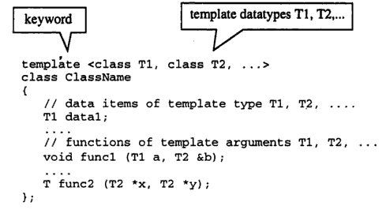
Class template
Classes can also be declared to operate on different data types
These classes model a generic class which supports similar operations for different data types

Slide 14
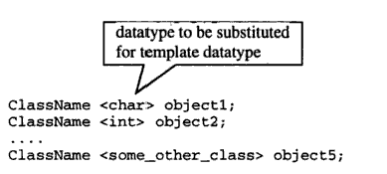
Class template
The prefix template <class T> specifies that template is being declared and typename T will be used in declaration
Any calls to the function and class templates needs to be associated with a data type
Syntax for creating objects of class template

Slide 15
Example
For example, a stack class can be defined as follows using templates:
template <class T>
class Stack
{
private:
int top;
T st[100];
public:
Stack();
void push(T i);
T pop();
};

Slide 16
The functions in a template class are also templates.
If the functions are defined inside the class, then they are defined just like normal c++ functions.
If they are defined outside the class, then the general form is,
template <class T>
returntype classname<T>::functionname(arglist)

Slide 17
For example:
template <class T>
void Stack<T>::push(T i)
{
st[++top] = i;
}

Slide 18
All objects must be of some specific size, so before creating an object of the template class, the data-type must be specified.
This is done by specifying the data-type as parameter when the object is created for the template class
The syntax for defining an object of template class is
classname <type> objectname;
Ex:
Stack<string> str_stack;

Slide 19
An instantiated object of a templated class is called a specialization
The term specialization is useful to remember because it reminds us that the original class is a generic class, whereas a specific instantiation of a class is specialized for a single datatype

Slide 20
Complete Example
#include <iostream>
#include <string>
using namespace std;
template <class T>
class Stack {
public:
Stack();
void push(T i);
T pop();
private:
int top;
T st[100];
};

Slide 21
template <class T>
Stack<T>::Stack()
{
top = -1;
}
template <class T>
void Stack<T>::push(T i)
{
st[++top] = i;
}
template <class T>
T Stack<T>::pop()
{
T data= st[top];
top--;
return data;
}

Slide 22
int main ()
{
  Stack<int> int_stack;
  Stack<string> str_stack;
  int_stack.push(10);
  str_stack.push("Hello");
  str_stack.push("World");
  cout << int_stack.pop() << endl;
  cout << str_stack.pop() << endl;
  return 0;
}

Slide 23
template <class T>
void Stack<T>::push(T i)
There are three T’s in this declaration:
  The first one is the template parameter.
  The second T refers to the type returned by the function.
  And the third T (the one between angle brackets) is also a requirement: It specifies that this function’s template parameter is also the class template parameter

Slide 24
Advantages
One C++ Class Template can handle different types of parameters.
Compiler generates classes for only the used types. If the template is instantiated for int type, compiler generates only an int version for the c++ template class.
Templates reduce the effort on coding for different data types to a single set of code

Slide 25
Additional Materials

Slide 26
Templates and Inheritance
Class template inheriting Regular class
Regular class inheriting Class Template
Class Template inheriting another Class Template

Slide 27
Class Template inheriting another Class Template
Both the base and derived classes are templates
Inheritance is used to extend the base-class template through the addition of new methods and/or data in the derived-class template

Slide 28
Example
  A common extension of the stack data structure is the addition of a method allowing the first element in the stack to be returned without being removed from the stack.
  Such a stack, InspectableStack, has all of the methods of a basic stack.
  It is desirable, therefore, to use inheritance so that the InspectableStack need not repeat the definition of methods already given in the Stack template class.
  Also, like the Stack template, the InspectableStack will be defined as a template so that it can be reused for many different classes

Slide 29
template <class T>
class InspectableStack : public Stack<T>
{
public: InspectableStack();
T Inspect(); // return without removing the first element
~InspectableStack();
};

Slide 30
The InspectableStack template can be elaborated and objects of the elaborated template can be declared as shown in the following code:
InspectableStack<type> obj;
obj.push(value); // base class method
obj.push(value); // base class method ...
type data = obj.pop(); // base class method
type newTop = obj.Inspect(); // derived class method

Slide 31
Regular class inheriting Class Template
A non-template derived class can inherit from a template base class if the template's parameter is fixed by definition of the derived class.
The public methods of the template class will be public methods in the derived class as well.
Thus when using the derived class we can use both the derived- and base-class methods to manipulate a derived-class object.
The types involved in the inherited operations reflect the template parameter of the derived class

Slide 32
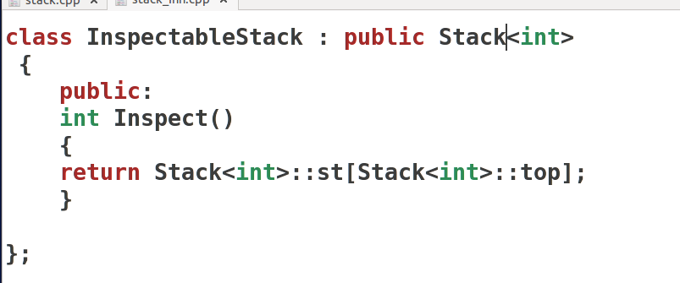

Slide 33
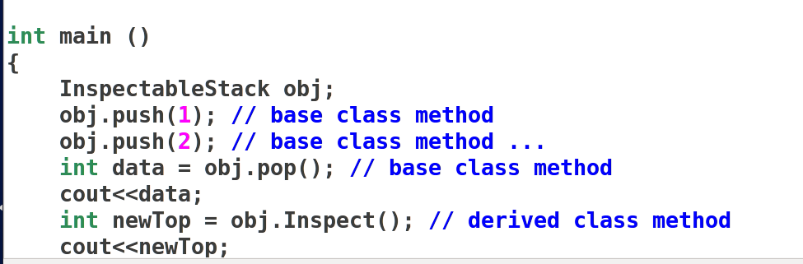

Slide 34
Class template inheriting Regular class
In this case, the derived class is a template class, but the base class is a non-template class.
The template parameter only has meaning to the derived class, not to the base class.
As with all other public inheritance, though, the derived class presents in its public interface all of the methods inherited from the base class, plus any other methods added by the derived class

Slide 35
Templates and static Members
Each class-template specialization (instantiation) has its own copy of each static data member
  All objects of that specialization share that one static data member
  static data members must be defined and, if necessary, initialized at file scope
Each class-template specialization gets its own copy of the class template’s static member functions

Slide 36
Example
Same search function can be used for
  Searching a student by roll no
  Searching a student by name
  Searching a employee by emp id
  Searching a employee by name

Slide 37
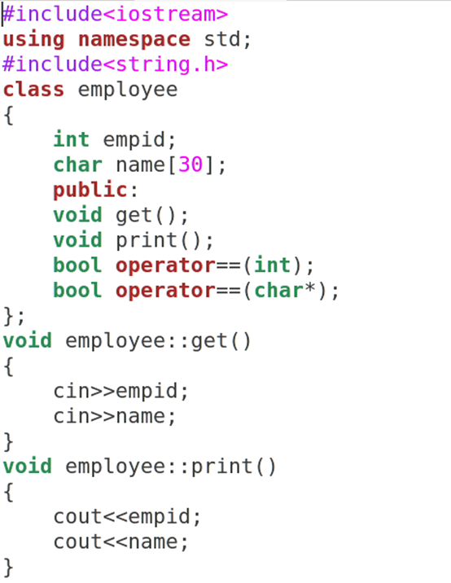

Slide 38
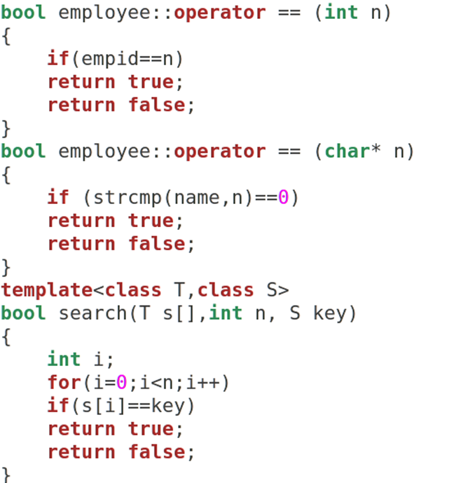

Slide 39
